Slide 1


Project Brainchild

Slide 2
| Datara Response
Project Brainchild
01
Introductions
Introducing the Datara team
02
Today’s Problems
Summation of the problem statements
03
Tomorrow’s Solution Today
Solution walkthrough
04
Benefits & Delivery
Defining the roadmap.

Slide 3




Project Brainchild
Paul Schweikert
Darren Webber
CTO
Operations Director
Paul Schweikert
Darren Webber
Duncan Yule
Stuart Henderson
Duncan Yule
Stuart Henderson
Technical Lead
Solution Designer

Slide 4
Project Brainchild
Problem Statements
SPEED
MANUAL
Insufficient velocity of throughput for M&A diligence activities
People. Documents. Heavy lifting Reading Understanding Deciding
RISKS
Narrow aperture for vision across M&A work streams leading to gaps and suboptimal decisions.

Slide 5
Solution Walkthrough
Brainchild in Action
“Design is the intermediary between information and understanding”
–Hans Hoffman

Slide 6
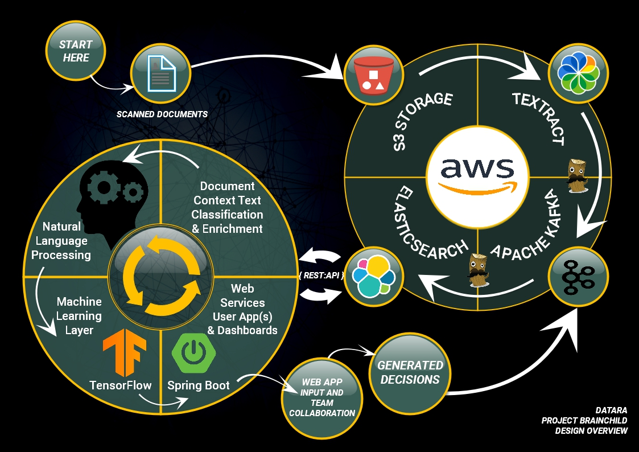


Project Brainchild

Slide 7



Scanned documents are transferred into secure, scalable and cost effective S3 storage.
These are then streamed through AWS Textract where the required data is extracted into usable forms.
Apache Kafka provides a solid persistence layer while offering opportunities for enrichment of the corpus.
The enriched corpus is then sent to Elasticsearch, where the fun begins.

Slide 8




Each Elastic index is optimised for Natural Language Processing. Multiple analyser processes run when each document is ingested.
Execute programmatic sequences made of queries, analysers and comprehensions designed to extract entities, meaning, context, affinity, tone and other dimensions from the Elasticsearch corpus.
The product of these NLP and relational-spatial-term frequency analysis is stored back into the Elasticsearch corpus.

Slide 9


The data accrued thus far can now be used to power a web application powered by Java Spring Web Services.
Qualifying documents can now be displayed in the browser for bio operators. The UI will feature interactive consoles to:
Direct user attention to the calculated content.
Permit additional input such as comments, annotations and confidence scores from expert users.
Facilitate user collaboration.
Push user content back into the Elasticsearch corpus.

Slide 10



The entire body of analysed content can now be extracted and a decision made. This decision should, to begin with, be reviewed by a human specialist.
If the human specialist agrees or not with the decision, the corpus can now be marshalled into JSON, pushed into a Kafka topic and used for Machine Learning.
This model can learn from what made the decision correct as well as what made the decision wrong. Machine Learning can be used to detect which components were significant in either case. This information can then be folded back into the process.

Slide 11
Better & Faster Decisions
Re-Imagine M&A
Automation
End to end automation
06
01
Project Brainchild
Special Value Points
End to end automation of the process will accelerate decisions and empower resources to add value in other ways.
Data as Interface
Plug in new applications seamlessly
Richer Data
Blending of data points and sources
05
02
When enriched data is exposed in Elastic the impact on M&A process and Swiss RE will be significant.
Visualization
Explore and model rich data visually
Instant Answers
Identify useful data quickly
Feedback loop between decisions, whether human or artificial, will ensure constant supply of Machine Learning training data.
04
03

Slide 12
Textract
API Pricing
 | First 1000 Pages | First 1,000,000 Pages (per page) | Effective price per 1000 pages | Over 1,000,000 Pages (per page) | Effective price per 1000 pages
Detect document text API | Free | $00.0015 | $01.50 | $00.0006 | $00.60
Analyze document text API with tables and forms | Free (100 Pages) | $00.065 | $65.00 | $00.05 | $50.00

Slide 13

Datara Closing statement
Why choose Datara? We are light and fast. Maneuverability is critical in projects like these where there is emphasis on early value and being blocked will quickly suffocate your stakeholders. We offer no complicated engagement models, no time-consuming escalation paths and certainly no red tape. The very team you see here today are ready to step into your world and deliver Project Brainchild.

Slide 14
Better & Faster Decisions
Re-Imagine M&A
Automation
End to end automation
06
01
Project Brainchild
Special Value Points
End to end automation of the process will accelerate decisions and empower resources to add value in other ways.
Data as Interface
Plug in new applications seamlessly
Richer Data
Blending of data points and sources
05
02
When enriched data is exposed in Elastic the impact on M&A process and Swiss RE will be significant.
Visualization
Explore and model rich data visually
Instant Answers
Identify useful data quickly
Feedback loop between decisions, whether human or artificial, will ensure constant supply of Machine Learning training data.
04
03

